Slide 1
SUBAXIAL CERVICAL SPINE TRAUMA- DIAGNOSIS AND MANAGEMENT

Slide 2
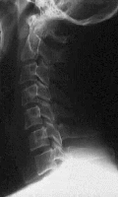
Anatomy
3 columns- Anterior, middle and Posterior
Anterior- ALL, Anterior 2/3 rd body & disc.
Middle- Posterior 1/3rd of body & disc, PLL
Posterior- Pedicle, lamina, facet, transverse process, spinous process, Ligaments- interspinous, lig.flavum
Articulations- Disc-vertebral body, Uncovertebral , Zygapophyseal joints.

Slide 3
Cervical spine injuries
Common cause of disability
Incidence
  Spine without cord injury- 3%
  Cord without #- 0.7%
Most commonly involves C5 and C6 levels.
Primarily involves adolescents and young adults
Males predominate.
Most common causes-
  RTA, Fall, Penetrating trauma, Sports

Slide 4
Clinical features
Neck pain
Restriction of neck movements
Neck tenderness
Varying degrees of neurological deficits
  Complete cord syndrome
  Incomplete cord syndrome
    Central cord syndrome
    Brown-Sequard syndrome
    Anterior cord syndrome
    Combination

Slide 5
Mechanisms of injury
A-Axial compression force
B- Hyperextension injury
C- Hyperflexion injury
Notes:
A-Axial compression force; B- Hyperextension injury; C- Hyperflexion injury

Slide 6
By mechanisms of injury
Flexion
  Anterior subluxation
  Unilateral facet dislocation
  Bilateral facet dislocation
  Wedge compression fracture
  Flexion teardrop fracture
  Clay Shoveler's fracture
Extension
  Hangman's fracture
Compression
  Jefferson fracture
  Burst fracture
Complex
  Odontoid

Slide 7
IMAGING
Lateral view
  Disc spaces, vertebral body, facet joints
AP view- Spinous process, Uncovertebral joints
Oblique view- Foramina, pedicles, facet joints, lateral mass, lamina

Slide 8
Up to 20 % of fractures are missed on conventional radiographs.
The sensitivity and specificity of CSR to detect fractures around 31.6 and 99.2%, respectively.
For radiographic clearance of the cervical spine- CT is a must.
CT- Excellent details about the # morphology.

Slide 9
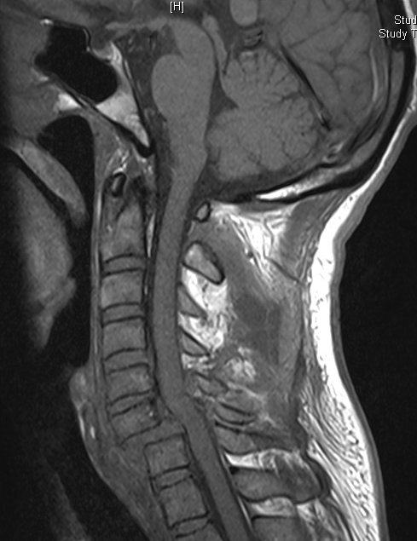
MR Imaging
Excellent soft tissue detail
To detect
  spinal cord integrity/ spinal cord changes/ disc herniations/ epidural blood
Supplementary to CT spine.

Slide 10
Classification
AO SPINE
SLIC
Allen

Slide 11
AO spine classification
Based on 2 column concept of Nicolle and Holdsworth.
Similar to the ones of thoraco-lumbar injuries
3 types- based on fundamental injury patterns
  A- vertebral body compression
  B- anterior and posterior element with distraction
  C- anterior and posterior element with rotation
Each type has 3 groups with 3 sub groups
Isolated spinous/ transverse process # not considered.
Type B and type C injuries are the dominating cervical spinal injuries.
The severity in terms of instability of the injuries as well as the rate of neurological deficits does not continuously increase from A to C in the cervical spine as it does in the thoracolumbar spine.

Slide 12
Type A (Compression) Fractures
Axial compression with or without flexion.
Height of vertebral body (anterior column) reduced.
Shortening of the anterior column
Posterior ligamentous complex intact (flexion/extension x-rays, MRI).
Translation in sagittal plane does not occur.
Rare in comparison to the thoracic and lumbar spine.
Posterior elements’ disruption to be always ruled out so as to classify as type A injury.

Slide 13
Group A1- Impaction #
Deformation of the vertebral body is due to compression of the cancellous bone rather than to fragmentation.
Posterior column is intact.
Narrowing of the spinal canal does not occur.
Injuries are stable.
Posterior vertebral body wall is intact.
Neurological deficit is very rare

Slide 14
  A1.1 end-plate impaction
  A1.2- wedge impaction
    Superior wedge impaction
    Lateral wedge impaction
    Inferior wedge impaction
  A1.3-Vertebral collapse fracture.
Rare in cervical spine.
No subluxation.
Posterior elements remain intact.

Slide 15
Group A2- split #
Vertebral body is split in the coronal or sagittal plane with a variable degree of dislocation of the main fragments.
When the main fragments are significantly dislocated, the gap is filled with disc material which may result in a nonunion .
Neurological deficit is uncommon
The posterior column is not affected.

Slide 16
  A2.1- Sagital split #
  A2.2- Coronal split#
  A2.3- Pincer #
Pincer #- Coronal fracture with dislocation of main fragments

Slide 17
Group A3- Burst #
Vertebral body is partially or completely comminuted with a centrifugal extrusion of fragments.
Fragments of the posterior wall are retropulsed into the spinal canal and may be the cause of neural injury.
The posterior ligamentous complex is intact.
Injury to the arch, if present, is always a vertical split through the lamina or spinous process.

Slide 18
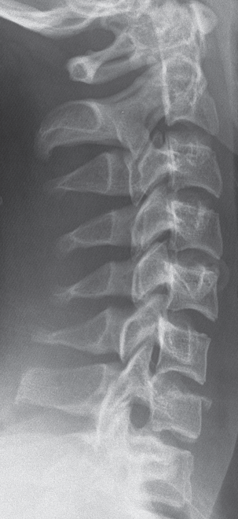
A3.1 incomplete burst fracture
  1. superior incomplete burst fracture
  2. lateral incomplete burst fracture
  3. inferior incomplete burst fracture
A3.2 burst-split fracture
  1. superior burst-split fracture
  2. lateral burst-split fracture
  3. inferior burst-split fracture
A3.3 complete burst fracture
  1. pincer burst fracture
  2. complete flexion burst fracture
  3. complete axial burst fracture
Pathognomonic feature-
  Broken, shortened posterior wall and
  Subsequent narrowing of the spinal canal often combined with a neurological deficit.
  Disc also usually involved.

Slide 19
TYPE B INJURIES—ANTERIOR AND POSTERIOR ELEMENT
INJURY WITH DISTRACTION
Account for almost half of all injuries
B component of an injury has to be looked carefully because it changes the prognosis dramatically
Typical features:
  Transverse disruption of one or both spinal columns initiated by flexion-distraction (posterior) or hyperextension (anterior).
  Translation dislocation in the sagittal direction.
The main criterion is a transverse disruption of one or both spinal columns.
Flexion/distraction initiates posterior disruption and elongation (B1 and B2)
Hyperextension with or without anteroposterior shear causes anterior disruption and elongation (B3).
In B1 and B2 injuries, the anterior lesion may be through the disc or a type A fracture of the vertebral body.

Slide 20
Group B1- Posterior disruption primarily ligamentous (Flexion distraction injuries)
Leading feature is disruption of the posterior ligamentous complex with bilateral subluxation, dislocation, or facet fracture.
Pure flexion-subluxations are only unstable in flexion, whereas pure dislocations are unstable in flexion and shear.
Neurological deficit is frequent and caused by translational displacement and/or vertebral body fragments retropulsed into the spinal canal.

Slide 21
B1.1- With transverse disruption of the disc
  1. Flexion subluxation
  2. Anterior dislocation
  3. Flexion subluxation/ anterior dislocation with # of articular process
B1.2- With type A # of vertebral body
  1. Flexion subluxation with type A # of body
  2. Anterior dislocation with type A # of body
  3. Flexion subluxation/ anterior dislocation with # articular process and type A # of body

Slide 22
Group B2- Posterior disruption primarily osseous (flexion-distraction injuries)
B2.1 transverse bi-column fracture (channel fracture)
B2.2 with disruption of the disc
  .1 disruption through the pedicle and disc
  .2 disruption through the pars interarticularis and disc (flexion spondylolysis)
B2.3 with type A fracture of the vertebral body
  .1 fracture through the pedicle and type A fracture
  .2 fracture through the pars interarticularis (flexion spondylolysis) and type A fracture

Slide 23
Group B3-anterior disruption through the disc (hypertension-shear injuries)
B3.1 hyperextension-subluxation
  .1 without injury of the posterior column
  .2 with injury of the posterior column
B3.2 hyperextension spondylolysis
B3.3 posterior dislocation

Slide 24
Type C- Anterior and posterior element injury with rotation
Rotational displacement.
Translational displacement in the coronal plane (pathognomonic).
Unilateral fractures of articular and transverse processes.
Lateral avulsion fractures of the end plate.
Account for 40% of all injuries in the lower cervical spine.
Therefore have a significant clinical importance.

Slide 25
Group C1: type A (compression) injuries with rotation
Very rare injuries.
C1.1 rotational wedge fracture
C1.2 rotational split fracture
  .1 rotational sagittal split fracture
  .2 rotational coronal split fracture
  .3 rotational pincer split fracture
C1.3 vertebral body separation (rotational burst fracture)
  .1 incomplete rotational burst fracture
  .2 rotational burst-split fracture
  .3 complete rotational burst fracture

Slide 26
Group C2: Type B injuries with rotation
C2.1- B1 injury with rotation (flexion-distraction injury with rotation)
C2.2- B2 injury with rotation (flexion-distraction injury with rotation)
C2.3- B3 injury with rotation (hyperextension-shear injury with rotation)
Flexion-rotation dislocation, unilateral facet interlocking, or dislocation are other commonly used terms for these—in most cases relatively stable—injuries.
Radiologic signs:
  3–4 mm subluxation of the vertebral body
  Abrupt change in the width of the interlaminar space.
  Alignment of the spinous processes may be impaired.

Slide 27
Group C3- Rotation shear injuries
Most unstable injuries.
C3.1 slice fracture
C3.2 oblique fracture
C3.3 Complete separation

Slide 28
Table 1. Subaxial Injury Classification (SLIC) Scale
Points
Morphology
No abnormality 0
Compression, burst 1,+ 1= 2
Distraction (e.g., facet perch, hyperextension) 3
Rotation or translation (e.g., facet dislocation,
unstable teardrop or advanced stage
flexion compression injury) 4
Discoligamentous complex
Intact 0
Indeterminate (e.g., isolated interspinous
widening, MRI signal change only) 1
Disrupted (e.g., widening of anterior disk
space, facet perch or dislocation) 2
Neurological status
Intact 0
Root injury 1
Complete cord injury 2
Incomplete cord injury 3
Continuous cord compression (neuro modifier
in the setting of a neurologic deficit) +1
SLIC>5
Surgical
SLIC<3
Conservative
SLIC=4
Equivocal

Slide 29
Which ones to be operated?
Type A 2 injuries
Type A 3 injuries
Type B injuries
Type C injuries

Slide 30
Management
Assess ABC
Initial neck immobilization in a hard collar.
Assess neurological status.
Check for associated injuries.
Role of steroids- Not a guideline (Only Class III evidence)
Imaging- Digital X ray C-spine, NCCT spine+/- MRI
Conservative v/s surgical management

Slide 31
Goals of treatment
A pain free patient with normal spinal function and a clinically stable spine
The maintenance or recovery of neurological function by reduction and decompression of neural elements.
Restoration of a physiological spinal alignment.
A definite bony healing of a surgically fused spinal segment.
An as short as possible stabilization and fusion
Number of segments involved in surgical management to be kept to a minimum.

Slide 32
Conservative treatment
Can be done in less severe deficits (ASIA D,E)
Cervical traction
Early mobilization (to prevent chest infections and bedsores)
Physiotherapy (Limb and chest)

Slide 33
SURGICAL TREATMENT
Timing of surgery
Type of surgery ( Anterior/ Posterior/ Combined)

Slide 34
Timing of surgical intervention
No clear consensus yet.
Currently no standards regarding the role and timing of decompression in acute SCI.
For injuries of the cervical spine there is some evidence that neurological recovery improved when the dislocation was reduced as early as possible
  Indication, surgical technique and surgical results of 100 surgically treated # and #-dislocations of cervical spine. Clin Orthop Relat Res; (203):244–257.
Currently no standards regarding the role and timing of decompression in acute SCI.
Role of surgical decompression in patients with SCI is only supported by Class III and limited Class II evidence.
  J Neurosurg. 1999 Jul;91(1 Suppl):1-11.

Slide 35
Early treatment in acute central cord injuries
  Reasonable and safe to consider early surgical decompression (<24 hrs) in patients with profound neurologic deficit (ASIA = C) and persistent spinal cord compression due to developmental cervical spinal canal stenosis without fracture or instability.
    Spine (Phila Pa 1976). 2010 Oct 1;35(21 Suppl):S180-6.
  Surgical intervention consisting of Open door expansile cervical laminoplasty can be safely applied in the subset of patients with ATCCS without instability who have significant cervical spondylosis/stenosis. 29 cases. Average delay from injury to surgery was 3 days.
    Surg Neurol. 2005 Jun;63(6):505-10
  Surgical decompression, however, was associated with immediate neurologic improvement, faster recovery of neurologic function, early mobilization, better long-term neurologic outcome, briefer hospital stays, and fewer complications related to long confinements in bed than was nonoperative treatment. 13/16 showed improvement.
    Spine (Phila Pa 1976). 1998 Nov 15;23(22):2398-403.

Slide 36
Recommended- Urgent decompression of bilateral locked facets in a patient with incomplete tetraplegia or in a patient with SCI with neurologic deterioration. Urgent decompression in acute cervical SCI remains a reasonable practice option and can be performed safely. There is emerging evidence that surgery within 24 hours may reduce length of intensive care unit stay and reduce post-injury medical complications.
66 articles were reviewed including 1 RCT
  Spine (Phila Pa 1976). 2006 May 15;31(11 Suppl):S28-35.

Slide 37
Anterior approaches
Discectomy and fusion.
Corpectomy
Anterior cervical plating

Slide 38
Posterior approaches
Posterior wiring technique and bone grafting approach
  Injuries of the posterior complex involving predominantly soft tissue with insignificant damage to the vertebral body.
  Enhancement of other posterior fusion techniques.
Lateral mass fixation
  Posterior stabilization of the cervical spine from C3 to C7.
  Biomechanically stronger than posterior wiring techniques and anterior plating
  Risks of injury to the vertebral artery and segmental nerve.
Others- not generally performed nowadays
  Interlaminar clamps
  Sublaminar wiring

